Slide 1

Basic Datastructure
ALP Jungwook Yang

Slide 2
Contents
I. Introduction
1. Memory
2. Binary Numbers: Computer’s Language
II. Variables
1. Pointers
2. Variables
3. Arrays
4. Shallow Copy
III. Program Pointer
1. Program Pointer
2. If statement, For loops

Slide 3
I. Introduction
1. Memory
-> Storage of Data
0
1
Blank Bit
Value 0
Value 1
Unit of the size of memory : bit
8 bit = 1 byte :
256 GB means : Your computer has 8 * 10^9 bits!

Slide 4
I. Introduction
2. Binary Numbers: Computer’s Language
What is decimal number: 10 is the base of number
For Example) 1024 = 1*10^3 + 0*10^2 + 2*10^1 +4*10^0
What is binary number: 2 is the base of number
Method to
Write Numbers on
Memory
For Example) 12
= 1*2^3 + 1*2^2 + 0*2^1 + 0*2^1 = 1100(2)
12
1
1
0
0

Slide 5
II. Variables
1. Pointers
Memory of the computer has this structure.
Value
Value: Stored value of memory
Adress: The position of memory(also a value)
Adress
10
0x0001
0x0000
0x0001
Pointer: A memory that has other memory’s address as a value

Slide 6

II. Variables
2. Variables
The base of variables are pointers.
Assignment operator “=“ makes variable point value. It means:
10
Actually means
a
0x0001
0x0000
0x0001
If not a value, “=“ makes left variable copy right variable’s value. It means:
a
0x0001
10
means
b
0x0001
0x0001

Slide 7

II. Variables
3. Arrays
The array type variables are stored like this.
means
1
2
3
4
L
0x0001
0x0000
[0]
[1]
[2]
[3]
0x0001

Slide 8
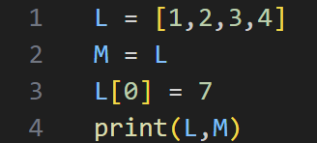
II. Variables
4. Shallow Copy
Quiz) What is the output?
a) [7,2,3,4] [7,2,3,4]
b) [1,2,3,4] [7,2,3,4]
c) [7,2,3,4] [1,2,3,4]
(a) Is correct!
L
0x0001
7
2
1
3
4
M
0x0001
[0]
[1]
[2]
[3]
0x0001

Slide 9
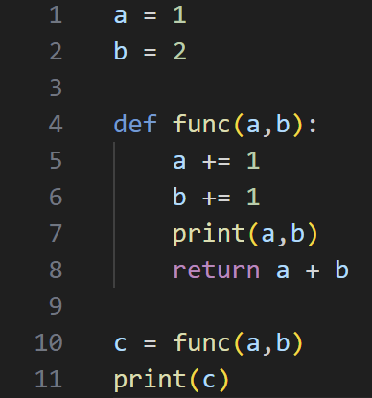
III. Program Pointer
1. Program Pointer
Then,
How function works?
-> The memory that saves the flow of the code
If program pointer meets function,
4
10
In this case, func(a,b)
It stores next line in Frame Pointer
Program
Pointer
Next, program pointer jumps into
define statement.
11
When indented line ended, program pointer
jumps into frame pointer position
Frame
Pointer

Slide 10
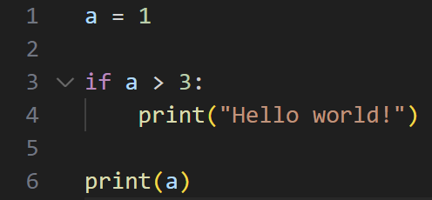
III. Program Pointer
2. If statement, For loops
Then,
How “if” works?
If program pointer meets if statement,
In this case, if a > 3:
If the statement is False,
program pointer jumps into end of if statement.
5
3
Program
Pointer

Slide 11
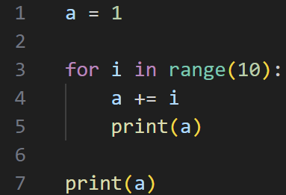
III. Program Pointer
2. If statement, For loops
Then,
How “for” works?
If program pointer meets for loop,
3
In this case, for i in range(10):
It stores next line in Frame Pointer
When indented line ended, program pointer
jumps into frame pointer position
Program
Pointer
4
Frame
Pointer

Slide 12
Thank You For Listening
ALP Jungwook Yang

